Slide 1
How to Do a Literature Review for a Thesis
Waweru Kamaku, PhD

Slide 2
Preview
Analytical synthesis, covering all known literature on the problem, including that in other languages. High level of conceptual linking within and across theories. Critical evaluation of previous work on the problem. Depth and breadth of discussion on relevant philosophical traditions and ways in which they relate to the problem

Slide 3
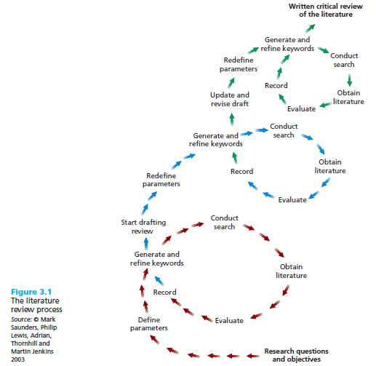

Slide 4
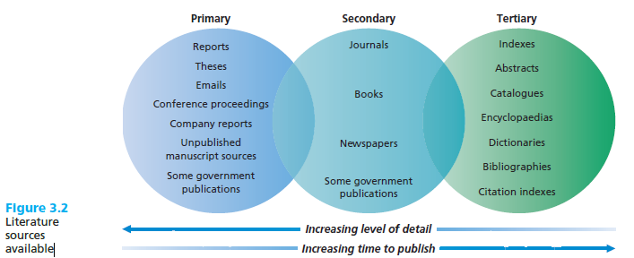

Slide 5
What needs to be included in a review of the literature?
• The key issues which underlie the research project
• The major findings on the research topic, by whom and when
• The main points of view and controversies that surround the issue being investigated
• A critical evaluation of these views, indicating strengths and weaknesses of previous studies on the topic
• General conclusions about the state of the art at the time of writing, including what research still needs to be done; that is, the gap that remains in the research that the study will aim to fill

Slide 6
Reading, summarizing and critiquing previous studies (Seliger and Shohamy, 1989)
Summarizing a previous study
• What are the major research questions or hypotheses in the study?
• What were the main findings of the study?
• Why was it important to carry out the research?
• What is the relationship between this study and the your own project?
• What other research studies were conducted in the same area?
• What is the relationship between these studies and your own project?

Slide 7
Summarizing research methods
• What research design was used in the study?
• What were the main variables in the study?
• What data was collected for the study?
• Describe the population, sample, and selection procedures for the sample
• Describe the data collection procedures used in the study
• How were the data collection procedures developed?
• Were issues of reliability and validity considered?

Slide 8
Analysis of the data
• How was the data analysed in the study?
• Were the analytic procedures quantitative, qualitative or both?
• Would you be able to re-analyse the data on the basis of the information provided about the analytic procedures?

Slide 9
Analysing findings
• What were the main findings of the study?
• How do the findings relate to previous research on the topic?
• What conclusions does the researcher reach on the basis of their findings?
• What are the implications of the findings?
• What recommendations does the researcher make based on the findings?
• What recommendations does the researcher draw from the results of their study?

Slide 10
Critiquing previous research
• Is the research problem clearly stated?
• Are the variables clearly described and defined?
• Is the design of the study appropriate for the particular research question?
• Are the research the instruments appropriate for the particular study?
• Are the data analysis procedures appropriate for the particular study?
• Was the author consistent in the way they analysed their results?
• Are the conclusions, implications, and recommendations warranted by the results?

Slide 11
Reporting on previous research
Central reporting
Burke (1986) discovered that many students would like to become integrated into Australian society.
Non-central reporting
It has been shown that students have often performed successfully in their own education system before they seek entry to the particular university (Ballard, 1991)
Non-reporting
Instead of motivation producing achievement, it may be that achievement produces motivation (Spolsky 1989)

Slide 12
Typical tenses used in the literature review
Tense
Simple present
Simple past
Present perfect
Example
Brown (1989) shows that .....................
" Brown (1989) showed that ...................."
Research has shown that ....... ..............."

Slide 13
Present simple
A generalisation is being made A reference is being made to the state of current knowledge Previous findings are being presented/are accepted as facts
Simple past
A reference is being made to a single study A specific piece of research and its findings are being referred to
Present perfect
A general area of investigation or inquiry is being referred to A general statement is made about previous research

Slide 14
References
Boote, D.N. and P. Beile (2005). Scholars before researchers: On the centrality of the dissertation literature. Educational Researcher. 34, 6: 3-16.
Bailey, S. (2006) Academic writing: a handbook for international students, Abingdon: Routledge.
Cahill, D. (1999) ‘Contrastive rhetoric, orientalism, and the Chinese second language writer’, unpublished PhD dissertation, University of Illinois at Chicago.
Cone, J.D. and Foster, S.L (1993) Dissertations and Theses: From Start to Finish, Washington, DC: American Psychological Association.
Hart, C. (1998) Doing a Literature Review, London: Sage. Hyland, K. (2004) Disciplinary interactions: Metadiscourse in L2 postgraduate writing, Journal of Second Language Writing, 13: 133-151.
Paltridge, B and S. Starfield. (2007). Thesis and Dissertation Writing in a Second Language. London: Routledge.
Phillips, E.M. and Pugh, D.S. (2005) How to Get a PhD, 4th ed, Buckingham, UK: Open University Press.
Seliger, H. and Shohamy, E. (1989) Second Language Research Methods, Cambridge: Cambridge University Press.

